Slide 1
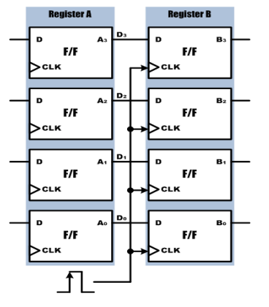
데이터의 저장과 전송

Slide 2
데이터의 저장과 전송
module registertrans(
input DATA_IN, CLK1,
output reg [3:0] A, B
);
always @(posedge CLK1)
begin
A <= DATA_IN;
end
always @(posedge CLK1)
begin
B <= A;
end
endmodule

Slide 3
`timescale 1ns / 1ps
module register_trans_tb;
reg DATA_IN; reg CLK1; wire [3:0] A; wire [3:0] B;
register_trans dut (
.DATA_IN(DATA_IN),
.CLK1(CLK1),
.A(A),
.B(B) );
initial begin
CLK1 = 0;
forever #5 CLK1 = ~CLK1;
end
initial begin
DATA_IN = 0;
$monitor("Time=%0t | DATA_IN=%b A=%b B=%b", $time, DATA_IN, A, B);
#7 DATA_IN = 1; #10 DATA_IN = 0;
#10 DATA_IN = 1; #10 DATA_IN = 1;
#10 DATA_IN = 0; #30; $finish;
end
endmodule

Slide 4
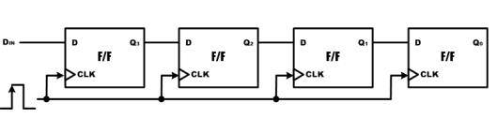
4bit 쉬프트 레지스터

Slide 5
4bit shiftregister(우쉬프트)
module shift4(
input RESETN, DATA_IN, CLK,
output reg [3:0] Q );
always @(posedge RESETN or posedge CLK)
begin
if (RESETN == 1'b1)
Q <= 4'b0000;
else
begin
Q[2:0] <= Q[3:1];
Q[3] <= DATA_IN;
end
end
endmodule

Slide 6
`timescale 1ns / 1ps
module shift4_tb;
reg RESETN; reg DATA_IN; reg CLK;
wire [3:0] Q;
shift4 dut (
.RESETN(RESETN), .DATA_IN(DATA_IN),
.CLK(CLK), .Q(Q) );
initial begin
CLK = 0;
forever #5 CLK = ~CLK;
end
initial begin
RESETN = 0;
DATA_IN = 0;
#3 RESETN = 1; #10 RESETN = 0;
#10 DATA_IN = 1; #10 DATA_IN = 0;
#10 DATA_IN = 1; #10 DATA_IN = 1;
#10 DATA_IN = 0; #10 RESETN = 1;
#10 RESETN = 0; #50 $finish;
end

Slide 7
initial begin
$monitor("TIME=%0t | RESETN=%b | DATA_IN=%b | Q=%b",
$time, RESETN, DATA_IN, Q);
end
endmodule

Slide 8
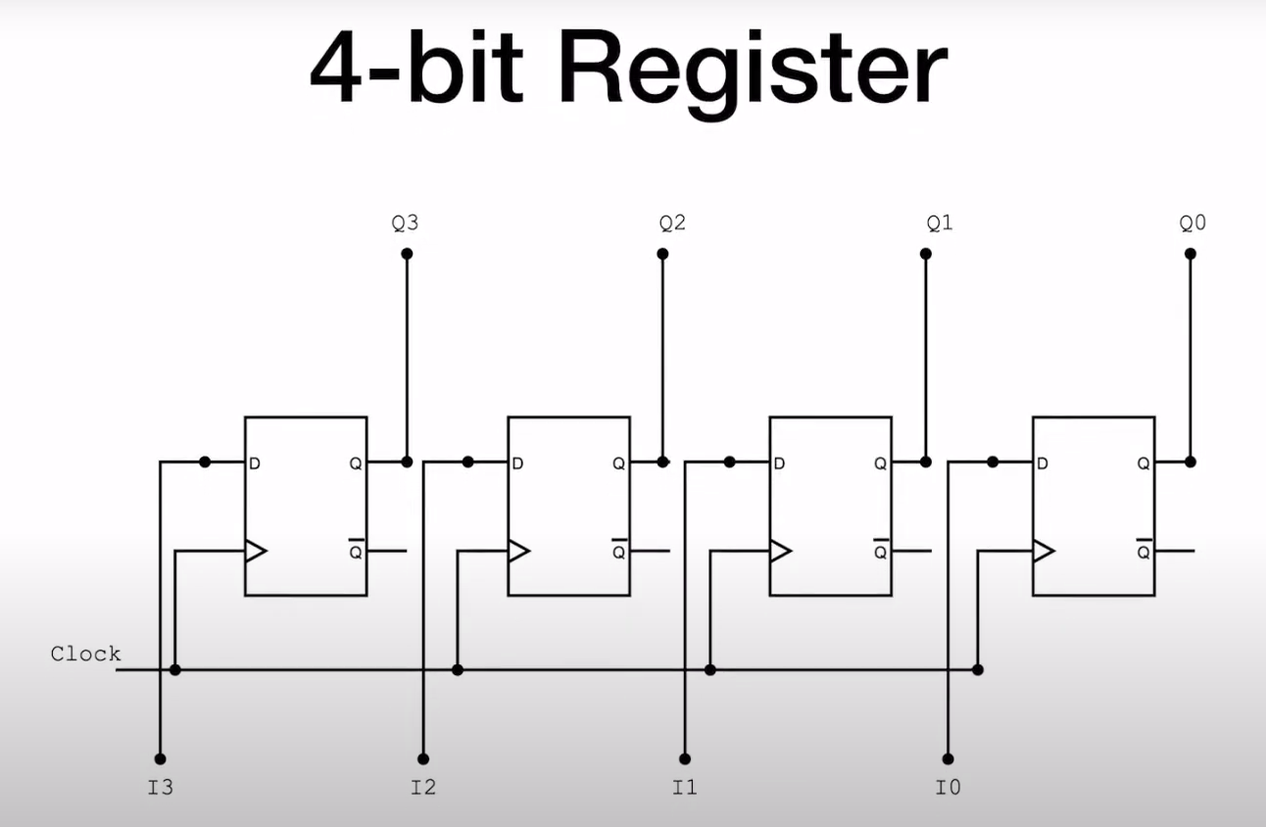
병렬입력 병렬출력 레지스터

Slide 9
module simple_register
#(parameter N = 4) (
input clk,
input [N-1:0] I,
output [N-1:0] Q );
reg [N-1:0] Q_reg, Q_next;
// 상태 저장 (순차회로)
always @(posedge clk)
begin
Q_reg <= Q_next;
end
// 다음 상태 결정 (조합회로)
always @(*)
begin
Q_next = I;
end
assign Q = Q_reg;
endmodule

Slide 10
`timescale 1ns/1ps
module simple_register_tb;
parameter N = 4;
reg clk;
reg [N-1:0] I;
wire [N-1:0] Q;
simple_register #(N) dut (
.clk(clk),
.I(I),
.Q(Q) );
always #5 clk = ~clk;
initial begin
clk = 0; I = 0;
#7 I = 4'b0001;
#10 I = 4'b0011;
#10 I = 4'b0101;
#10 I = 4'b1111;
#10 I = 4'b1010;
#20 $finish;
end
endmodule

Slide 11
4bit 병렬입력 병렬출력
module pipo(
input CLK, CLRN,
input [3:0] D,
output reg [3:0] Q
);
always @(posedge CLRN or posedge CLK)
begin
if (CLRN)
Q <= 4'b0000;
else
Q <= D;
end
endmodule

Slide 12
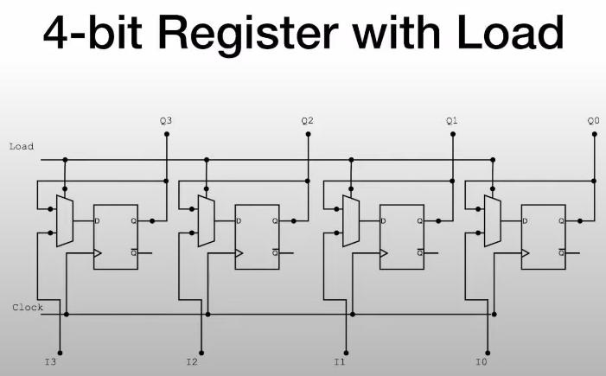

Slide 13
module register4withload
#(parameter N= 4) (
input load,
input clk.
input [N-1: 0] I,
output [N-1: 0] Q
);
reg [N-1:0] Q_reg, Q_next ;
always@(poosedge clk)
begin
Q_reg <= Q_next;
end
always@(I, load)
begin
if(load)
Q_next = I ;
else
Q_next = Q_reg ;
end
assign Q = Q_reg ;
endmodule

Slide 14
`timescale 1ns / 1ps
module register_with_load_tb;
parameter N = 4;
reg clk;
reg load;
reg [N-1:0] I;
wire [N-1:0] Q;
register_with_load #(N) dut (
.clk(clk),
.load(load),
.I(I),
.Q(Q)
);
initial begin
clk = 0;
forever #5 clk = ~clk;
end

Slide 15
initial begin
load = 0;
I = 4'b0000;
$monitor("Time=%0t | load=%b I=%b Q=%b", $time, load, I, Q);
#10; I = 4'b1010;
#10; I = 4'b1111;
#10; load = 1;
I = 4'b1100;
#10; I = 4'b0011;
#10; load = 0; I = 4'b0101;
#20; load = 1; I = 4'b1110;
#10;
#20; $finish;
end
endmodule

Slide 16
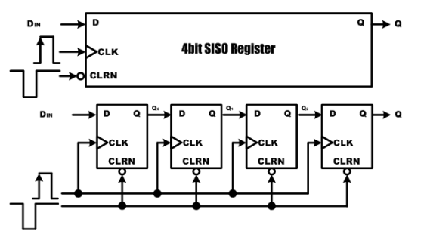
직렬입력 직렬출력 레지스터

Slide 17
직렬입력직렬출력(좌쉬프트)
module siso(
input CLK, CLRN,
output DIN, Q
);
reg [3:0] BUFF;
always @(negedge CLRN or posedge CLK)
begin
if (CLRN == 1'b0) BUFF = 4'b0000;
else
begin
BUFF[3:1] = BUFF[2:0];
BUFF[0] = DIN;
end
end
assign Q = BUFF[3] ;
endmodule

Slide 18
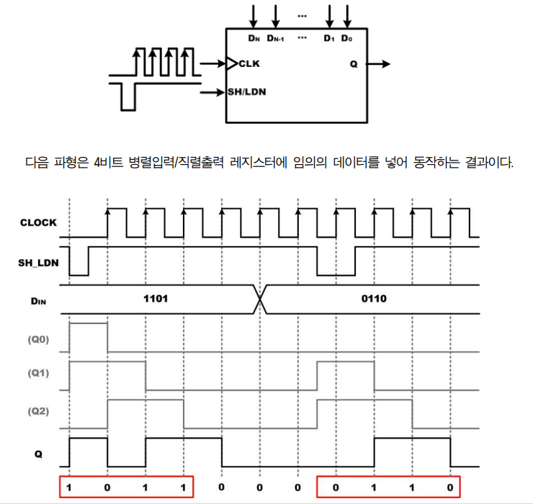
병렬입력 직렬출력 레지스터

Slide 19
병렬입력직렬출력
module piso4(CLK, SH_LDN,D, Q);
input CLK, SH_LDN;
input [3:0] D;
output Q;reg [3:0] BUFF;
wire Q;
always @(negedge SH_LDN or posedge CLK)begin
if (~SH_LDN)BUFF = D;
else
begin BUFF[3:1] = BUFF[2:0];BUFF[0] = 1'b0;
end
end
assign Q = BUFF[3];
endmodule

Slide 20
`timescale 1ns / 1ps
module piso4_tb;
reg CLK;
reg SH_LDN;
reg [3:0] D;
wire Q;
piso dut (
.CLK(CLK),
.SH_LDN(SH_LDN),
.D(D),
.Q(Q) );
always #5 CLK = ~CLK;

Slide 21
initial begin
// 초기값
CLK = 0;
SH_LDN = 1; // 기본은 shift 상태
D = 4'b0000;
#3 D = 4'b1101;
SH_LDN = 0; // load 시작 (negedge 유도)
#2 SH_LDN = 1; // 다시 shift 모드
#40;
#3 D = 4'b1010;
SH_LDN = 0;
#2 SH_LDN = 1;
#40; $finish;
end
endmodule

Slide 22
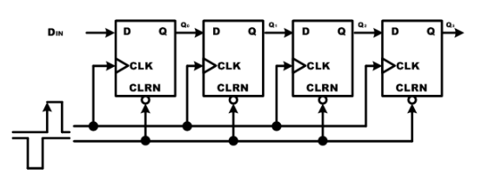
직렬입력 병렬출력 레지스터

Slide 23
module sipo(
input CLK, RESETN,
input DATA_IN,
output reg [3:0] Q
);
always @( negedge RESETN or posedge CLK)
begin
if (RESETN)
Q = 4'b0000;
else
begin
Q[2:0] = Q[3:1];
Q[3] = DATA_IN;
end
end
endmodule

Slide 24
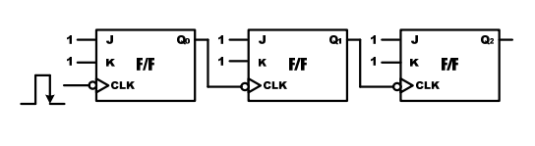
비동기식 카운터

Slide 25
비동기식 카운터
module asyncount (
input CLK,
output reg [2:0] Q );
always @(negedge CLK) begin
if (Q[0] == 1'b0 )
Q[0] = 1'b1;
else
Q[0] = 1'b0;
end
always @(negedge Q[0]) begin
if (Q[1] == 1'b0 )
Q[1] = 1'b1;
else
Q[1] = 1'b0;
end
always @(negedge Q[1]) begin
if (Q[2] == 1'b0 )
Q[2] = 1'b1;
else
Q[2] = 1'b0;
end
endmodule

Slide 26
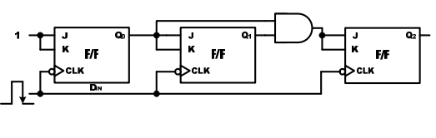
동기식 카운터

Slide 27
동기식카운터
module synccount(
input RESETN, CLK,
output reg [2:0] Q
);
always @(posedge RESETN or negedge CLK)
begin
if (RESETN) Q = 3'b000;
else if (Q >= 3'b111 ) Q = 3'b000;
else Q = Q + 1;
end
endmodule

Slide 28
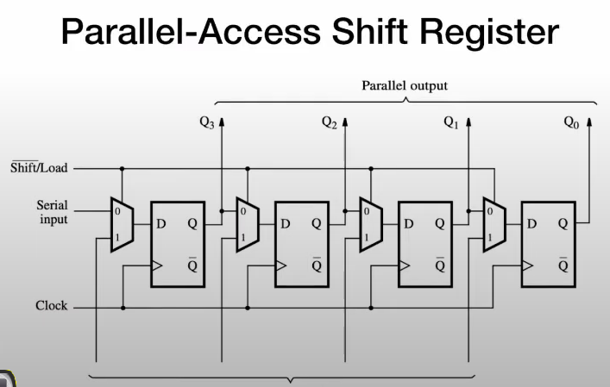

Slide 29
module paralaccess_register
#(parameter N= 4) (
input clk. input SI, input [N-1:0] I, input load, input reset_n, output [N-1:0] Q,
output SO
);
reg [N-1:0] Q_reg, Q_next ;
always@(poosedge clk, negedge reset_n)begin
if(!reset_n) Q_reg <= 1’b0 ;
else Q_reg <= Q_next ;
end
always@(SI , Q_reg)
begin
if(load) Q_next = I ;
else Q_next = {SI, O_reg[N-1:1]};
assign SO = Q_reg[0] ;
assign Q = Q_reg ;
endmodule

Slide 30
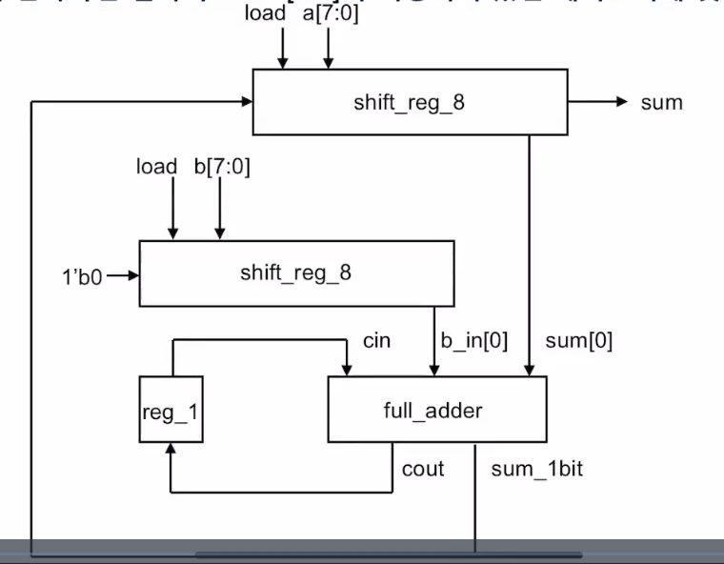

Slide 31
`timescale 1ns / 1ps
module serialadder(
input clk,rstb,load, [7:0] a, b,
output [7:0] sum
);
wire [7:0] b_in;
parallel8shift dut1(.clk(clk), .rstb(rstb), .sin(sum_1bit), .din(a), .pout(sum), .load(load));
parallel8shift dut2(.clk(clk), .rstb(rstb), .sin(1'b0), .din(b), .pout(b_in), .load(load));
register_1 dut3(.clk(clk), .rstb(rstb), .din(cout), .dout(cin));
full_adder dut4(.a(sum[0]), .b(b_in[0]), .cin(cin), .cout(cout), .s(sum_1bit));
endmodule

Slide 32
module parallel8shift(
input clk,
input rstb,
input load ,
input sin,
input [7:0]din,
output reg [7:0] pout );
always@(posedge clk or negedge rstb) begin
if (!rstb) pout[7:0] <= 8'b0;
else if(load) pout[7:0] <= din[7:0];
else pout[7:0] <= {sin, pout[7:1]};
end
endmodule

Slide 33
module register_1(
input clk, rstb,
input din,
output reg dout);
always@(posedge clk, negedge rstb)
// dout <= !rstb? 1'b0: din;
dout <= din;
endmodule
module full_adder(
input a,b,cin,
output s,cout);
assign cout = a&b | b&cin | cin &a;
assign s = a^b^cin;
endmodule

Slide 34
`timescale 1ns / 1ps
module serialadder_tb;
reg clk, rstb, load;
reg [7:0] a,b;
wire [7:0] sum;
serialadder dut( .clk(clk), .rstb(rstb), .load(load), .a(a), .b(b), .sum(sum));
initial clk = 0;
always #5 clk = ~clk;
initial begin
#0 a[7:0] = 8'h29; b[7:0] = 8'h35; rstb = 0; load = 0;
#10 rstb = 1;
#10 load = 1;
#10 load =0;
#100 load = 1; a=8'h03; b=8'h89;
#10 load = 0 ;
#200 $stop;
end
endmodule

Slide 35
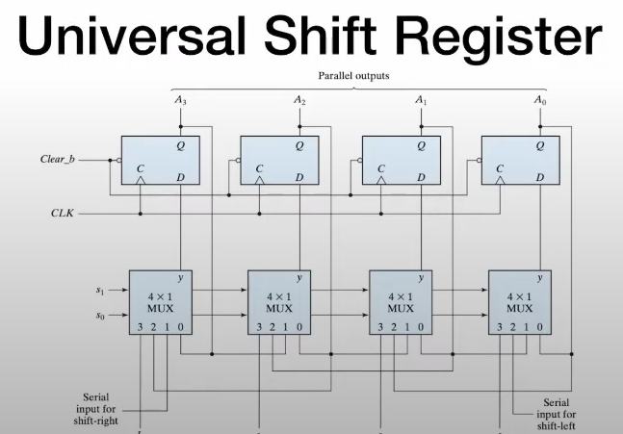
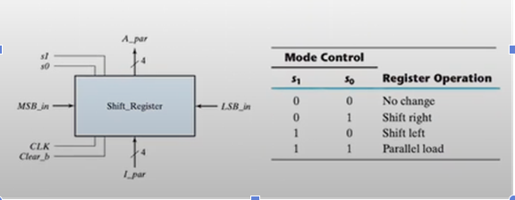

Slide 36
module universal_register
#(parameter N= 4) (
input clk. reset_n, input [N-1:0] I, input [1:0] s,
output [N-1:0] Q );
reg [N-1:0] Q_reg, Q_next ;
always@(posedge clk, negedge reset_n)
begin
if(!reset_n)
Q_reg <= 1’b0 ;
else
Q_reg <= Q_next ;
end
always@(Q_reg, MSB_in, LSB_in, I) begin
Q_next = Q_reg ;
case(s)
2’b00: Q_next = Q_reg ;
2’b01: Q_next = {MSB_in, Q_reg[N-1:1]} ;
2’b10: Q_next = {Q_reg[2:0], LSB_in } ;
2’b11: Q_next =I;
default : Q_next = Q_reg ;
endcase
end
assign Q = Q_reg ;
endmodule

Slide 37
`timescale 1ns / 1ps
module universal_tb ;
reg clk, reset_n; reg [N-1:0] I;
reg [1:0] s;
reg MSB_in, LSB_in;
wire [N-1:0] Q ;
parameter N=4;
universal_register dut(clk, reset_n, I, s, MSB_in, LSB_in, Q);
initial begin
clk = 0;
repeat(40) #20 clk = ~clk;
end
initial begin
reset_n = 1;
#2 reset_n = 0;
#2 reset_n = 1;
end
initial begin
I= 0111;
#250 I= 1101 ;
end

Slide 38
initial begin
#5 s= 2'b11;
#40 s = 2'b01;
#40 s = 2'b01;
#40 s = 2'b01;
#40 s = 2'b10;
#40 s = 2'b10;
#40 s = 2'b00;
#40 s = 2'b10;
#40 s = 2'b10;
end
initial begin
MSB_in = 0;
LSB_in = 0;
end
endmodule

Slide 39
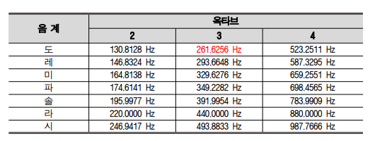
PIEZO
module HB_PIEZO( RESETN, CLK, PIEZO );
input RESETN, CLK; output PIEZO;
reg BUFF; integer CNT_SOUND;
wire PIEZO;
always @(posedge RESETN or posedge CLK)
Begin
if (RESETN) begin
BUFF = 1'b0
CNT_SOUND = 0;
end
else
begin
if (CNT_SOUND >= 1910)

Slide 40
//도레미파솔라시도 출력 프로그램
module HB_PIANO (
RESETN, CLK, KEY, PIEZO );
input RESETN, CLK;
input [7:0] KEY;
output PIEZO;
reg BUFF;
reg [7:0] CNT_SOUND;
reg [7:0] LIMIT;
wire PIEZO;
always @(KEY)
begin
case (KEY)
8'b10000000 : LIMIT = 1910; // DO
8'b01000000 : LIMIT = 1701; // RAE
8'b00100000 : LIMIT = 1516; // MI
8'b00010000 : LIMIT = 1431; // FA
8'b00001000 : LIMIT = 1275; // SOL
8'b00000100 : LIMIT = 1135; // RA
8'b00000010 : LIMIT = 1011; // SI
8'b00000001 : LIMIT = 955; // High DO
default : LIMIT = 0;
endcase
end

Slide 41
always @(posedge CLK) begin
if (RESETN)
Begin
BUFF = 1'b0;
CNT_SOUND = 0;
end
Else
begin
if (CNT_SOUND >= LIMIT)
Begin
CNT_SOUND = 0;
BUFF = ~ BUFF;
end
Else
CNT_SOUND = CNT_SOUND + 1;
end
end
assign PIEZO = BUFF;
endmodule

